Slide 1
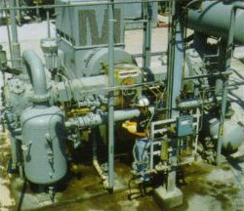
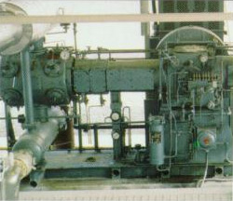
Reciprocating Compressor Application

Slide 2
Reciprocating Compressor Application
Maintenance Cost are 3.5 X that of centrifugal equipment.
Condition Monitoring can achieve substantial savings in
maintenance cost and in increased run time.
Notes:
Reciprocating Compressors are utilized in all manufacturing industries.The total quantity of positive displacement reciprocating engines, pumps, and compressors far exceed the number of centrifugal units. Because these machines are capable of providing high pressure along with variable loading, they are favored for many gas processing applications.
Past studies in the Hydrocarbon Processing Industry indicate that the maintenance cost are approx. 3.5 X that of centrifugal equipment. Substantial savings in maintenance cost and an increase in run time may be achieved through basic monitoring of some if not all of the following machine parameters:

Slide 3
Reciprocating Compressor Measurement Parameters:
Frame Vibration
Crosshead Vibration
Rod Drop
Rod Run-Out
Main Bearing Vibration
Valve Temperature
Rod Loading

Slide 4
Frame Vibration
Prevent Catastrophic Failure and reduce overall damage
Most common method of tripping machine.
Replaces OEM supplied “Earthquake” switch.
Frame Vibration
Notes:
The most important vibration parameter of a successful monitoring program is Frame Vibration. When properly applied, monitoring Frame Vibration will prevent catastrophic failures. In the event of a failure, dame to the machine can be reduced.
For the greatest benefit, Frame Vibration should be wired to an automatic machine trip. To decrease the possibility of a false trip, two case mounted accelerometers should be mounted relatively close to each other. The outputs from the two sensors are signal conditioned, and their trip circuits are “AND” voted. In other words, before a trip is initiated, both of the transducers must sense a high vibration level.
The SKF CMSS2100 Accelerometer is highly recommended for FV. It’s low frequency response of 0.8 Hz and standard scale factor of 100 mV/g, and relatively low cost are desired features for this application. The two CMSS2100’s should be perpendicular to the shaft and oriented in the direction of Piston travel. The transducers must be mounted on a surface that allows direct transmission of the Frame’s vibration. Avoid mounting the transducers on a cover or door.

Slide 5
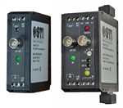
Advantages over OEM “EARTHQUAKE” Switch
Solid State Design (Long Life)
Low Frequency Response
Indication of Vibration Levels
Alert & Danger Alarms
Shutdown “AND” Voting
Fault Detection
Vibration Diagnostic Capability
CMCP530
Velocity Monitor
Notes:
The CMSS2100 should be interfaced with a CMCP530 Velocity Monitor. This combination offers numerous advantages over an OEM supplied “EARTHQUAKE” Switch.

Slide 6
Crosshead Vibration
Crosshead Vibration
Notes:
The Crosshead of a Recip is made up of several major components: Crosshead Bed, Crosshead Slippers & Crosshead Pin. The purpose of the Crosshead is to transform the circular motion of the crankshaft into linear motion for the rod and piston. The Crosshead slides on a lubricated babbitted surface much like a standard journal bearing. However the Crosshead slides back and forth instead of a circular motion like a shaft. Clearance between the Crosshead and the babbitt surface may range from 10 to 25 mils. As the crankshaft rotates, the Crosshead is driven to slide on either the upper or lower babbitt surface. Crosshead vibration will increase as the clearance between the Crosshead and the babbitt surfaces increases.

Slide 7
Crosshead Vibration
Accelerometer
and CMCP280 Housing
CMCP525
Acceleration Transmitter/Monitor
Increased clearance between Crosshead and the Babbitt surfaces.
Indicator of Crosshead Pin “reversal” problem.
Loose Rod Nuts & Bolts
Liquid in the process
Machine shutdowns for repair can be scheduled.
Notes:
Experience has shown that an accelerometer, mounted on a 45 degree angle block, located in-line with the piston, will adequately measure vibration. Crosshead Pin lubrication can also be diagnosed with this transducer. The Crosshead Pin connects the connecting rod from the crankshaft to the Crosshead. This pin is force lubricated via “reversal” which allows oil between the pin and its bushing. With each stroke, the oil is forced out. If “reversal” does not occur, the pin and its busing will fail rapidly.
By measuring vibration in Peak Acceleration instead of RMS detection, we can measure high amplitude short duration “peaks” or “events” that appear periodically. The crosshead mounting location in-line with the piston travel will see the mechanical transfer of energy, caused by impacts resulting from mechanical looseness on compressor cylinders, such as loose rod nuts, and loose bolts. Liquid in the process can also be detected. Competitive offerings refer to this measurement as Rod Impact monitoring.
The Accelerometer is interfaced to a CMCP525 Acceleration monitor which will condition the signal and provide a 4-20mA output proportional to vibration in terms of Peak Acceleration.

Slide 8
Rod Drop
Rod Drop
Notes:
The vast majority of Reciprocating Compressors are designed with Horizontal Cylinders and Pistons. This is primarily due to foundation requirements and the popularity of opposed-balanced machine designs. The force of gravity causes the piston to “Ride” more in the bottom of the Cylinder than in the top. In turn, this causes the piston to wear more in the “down” direction. Rider rings are positioned within the cylinder to provide a replaceable wear surface. These wear, or rider rings are allowed to wear sacrificially. They are rotated or replaced before damage to the cylinder lining occurs.

Slide 9
Rod Drop
Eddy Probe
System
CMCP545
Position Transmitter/Monitor
Eliminate periodic inspections that require
Machine shutdown and disassembly
Provide real time trend of rider ring wear.
Notes:
The most popular method of determining when to rotate or replace the rings is Rod Drop Monitoring. The measurement is made with an Eddy Current Probe, mounted in a vertical direction, directly viewing the rod. The preferred installation would have a probe bracket adapted to the packing gland plate, mounted internal to the distance piece. As an alternate solution, some users have used the CMCP801 probe housing, providing for an external adjustment of the probe gap. As the Eddy Probe field will penetrate the rod surface approximately 15 mils, it is important that the observed rod be homogenous in nature and free of any surface irregularities.
The Eddy Probe system is interfaced to a CMCP545 Position Monitor to measure the probe’s DC output (Probe Gap). By trending the DC Gap voltages from the eddy probe, it is possible to measure the average horizontal running position of the piston rod. The CMCP545 provides two levels of alarm, corresponding Alert and Danger relays and a 4-20 mA output proportional to the DC Gap voltage.

Slide 10
Rod Runout
X,Y
Eddy Probe
System
CMCP540
Displacement Transmitter/Monitor
Assurance that Rod Run Out is within tolerable limits
after the machine is at operating speed and temperature.
Provide early warning of gland seal failure
caused by Rod Run Out.
Alarms & Shutdown available.
Notes:
Whereas Rod Drop is a measurement of Rod Position, Rod Run Out is a measurement of the rod’s actual dynamic motion as it travels back and forth on its stroke. Another term for this measurement is Rod Deflection. The amount of Rod Run Out is highly dependent on the cylinder alignment with the Crosshead. Due to inherent looseness in the Crosshead and thermal growth of the machine, higher readings are allowed in the vertical direction. The horizontal allowances are much less and high readings are attributed to misalignment. Typical Rod Run Out allowances are 3.5 to 6.0 mils Pk-Pk in the vertical direction and 1.5 to 2.0 mils Pk-Pk in the horizontal direction.
Rod Run Out is typically measured on “Hyper Compressors”. These machines are used for very high compression ratios and up to 60,000 PSI discharge pressure. To withstand the high pressures, the gland seals on these machines are quite complex and small amounts of Rod Run Out will cause these seals to fail. Hyper compressor piston rods are manufactured of Tungsten Carbide. Tungsten Carbide is a very hard material (Rockwell C values of approximately 84); will handle enormous compressive loads, but is much weaker when subjected to tension or flexing. Either a gland seal or piston rod failure in a Hyper Compressor will have severe consequences.
Utilizing the AC component (dynamic motion) of an Eddy Probe signal, one eddy probe is mounted in the vertical (X) axis and one is mounted in the horizontal (Y) axis in relation to the piston rod. Each eddy probe is interfaced to a CMVP540 Displacement Monitor for signal conditioning, alarming and interface to a PLC or DCS.

Slide 11
Main Bearing Vibration
X,Y
Eddy Probes
CMCP540
Displacement Transmitter/Monitor
Provide early warning of main bearing failure
Alarms & Shutdown available.
Notes:
While not a popular measurement on reciprocating compressors, Main Bearing Vibration measurement has validity on gas fired reciprocating engines. Several end users have had problems with broken crankshafts which they thought were caused by unusual bending of the crankshaft. In one documented case, a machinist had over tightened the drive belts powering the cooling fan on a reciprocating engine – causing improper bending of the crankshaft.
Eddy Probes view the crankshaft from the bottom bearing cap, and are mounted 90 degrees apart as on a centrifugal machine. The eddy probes are connected to a CMCP540 Displacement Monitor for signal conditioning, alarming and interface to a PLC or DCS.
A cost effective compromise would be to install a CMSS2100 accelerometer mounted in line with the crankshaft centerline and interface it to the CMCP530 Velocity Monitor.

Slide 12
Valve Temperature
44 Temperature Points
on this machine...
Valve Temperature
Cylinder
Valve failures account for greater than 40% of problems.
Notes:
According to industry studies, valve failures account for 41% of the problems associated with reciprocating machinery. These valves area pressure activated “Poppet” variety. These valves operate utilizing a delta or differential pressure technique. The opening and closing of a valve occurs when the delta pressure is less than the force of their return springs.
When a valve begins to fail, it usually begins to leak the process gas. This causes the process gas to be re-compressed, thus further heating the gas. This higher temperature process gas can be detected using a temperature transducer.

Slide 13
Valve Temperature
Valve Temperature
RTD
Cylinder
Valve Cover
Provide early indication of valve problem.
Isolates the problem valve for repair.
Trending condition allows for scheduled
shutdowns.
Prevent damage to cylinder lining that occurs
when valve parts are ingested by the machine.
CMCP560
RTD Transmitter/Monitor
Notes:
This transducer (RTD) can be mounted through the valve cover plate. In some applications, the sensor is simply imbedded within a valve cover plate bolt. This mounting method is preferred when the process gas is explosive, which usually is the case.
Each RTD is connected to a CMCP560 RTD Monitor for alarming and interface to a PLC or DCS.

Slide 14
Explosion Proof
Transducer Housings
Transducer terminations
(+) and (-) 24Vdc Power Supplies
CMCP500 Series
Transmitter/Monitors
A/D Converter with DCS
protocol.
Notes:
To lower the installed cost of an on-line monitoring system, CMCP has created a “Plug & Play” scenario where all the sensors associated with each stage of the machine are “Packaged” in an explosion proof enclosure and “dropped” at each cylinder. Each housing contains the appropriate sensor terminations, power supplies, transmitter/monitors and A/D Converter.

Slide 15
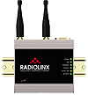
Digital Link to HMI/PLC/DCS
Explosion Proof Housings
Xdrs
Xdrs
Xdrs
Ethernet Cat5e or
Multi-Drop Link
Xdrs
Xdrs
Xdrs
24 VDC or
110/220 VAC
Explosion Proof Housings
Notes:
110VAC (or 24 VDC) is then wired to each of the enclosures. Each A/D Converter is daisy-chained to the next enclosure and then interfaced to the plants DCS Multi-Drop Link. In this example, wiring for 59 sensors was converted to a single twisted pair and interfaced into the Plant DCS network; significantly lowering the system cost when compared to competitive offerings requiring individual sensor wiring via hard conduit all the way back to a control room.

Slide 16
Rod Load
Phase Reference
F=PA
Inboard
F=PA
Outboard
Pressure Sensor
Mounted Inboard & Outboard through Cylinder Wall
Notes:
Rod Loading is a parametric measurement calculated from force measurements that are related to the piston surface area and the cylinder pressure. For each cylinder you can derive a force measurement. For a double acting compressor you would have a force measurement for the outboard portion of the cylinder and another force measurement for the inboard portion of the cylinder. Rod Loading is simply the net force of the inboard and outboard portions of the cylinder. You can obtain instantaneous vector measurement by utilizing a phase reference on the crank as a timing mark and combining that with a force measurement with each cylinder. A non balanced cylinder can lead to crosshead pin and bushing lubrication problems because Pin Reversal doesn’t occur.

Slide 17
Auxiliary Equipment Monitoring
Motor Drive:
Accelerometer on coupled & Outboard bearing in Horizontal direction (Velocity Measurement).
Gas Engine:
Accelerometer inside the engine on main bearing supports for detonation & mechanical looseness detection (Acceleration Measurement).
Turbochargers, Cooling Water Fans, Water Pumps, and Oil Pumps
Notes:
Budget allowing, Auxiliary equipment should be included in your condition monitoring scheme. Generally speaking, an accelerometer or transmitter placed in the horizontal direction on each radial bearing is sufficient. The vibration is typically measured in terms of velocity.

Slide 18
Reciprocating Compressor Monitoring Summary
CMCP786 Accelerometer
(Crosshead Vibration)
Eddy Probe
(Phase Reference)
Eddy Probe
(Rod Drop)
Pressure Sensors
CMCP786
Accelerometer
(Frame Vibration)
Temperature Sensors
Notes:
Reciprocating machines have been considered less sophisticated than centrifugal units. In reality, reciprocating machines are more complex, with many more moving parts than centrifugal equipment. As discussed earlier, reciprocating units long-term maintenance costs are significantly greater than centrifugals. CMCP’s modular, single point, distributed monitoring approach can greatly improve the reliability of reciprocating machines while providing a very cost effective solution.
CMCP’s Reciprocating Compressor Monitoring Package includes an Operator Interface via Wonderware (the world’s leading HMI). Let’s take a look at typical screens that the Wonderware interface can provide.

Slide 19
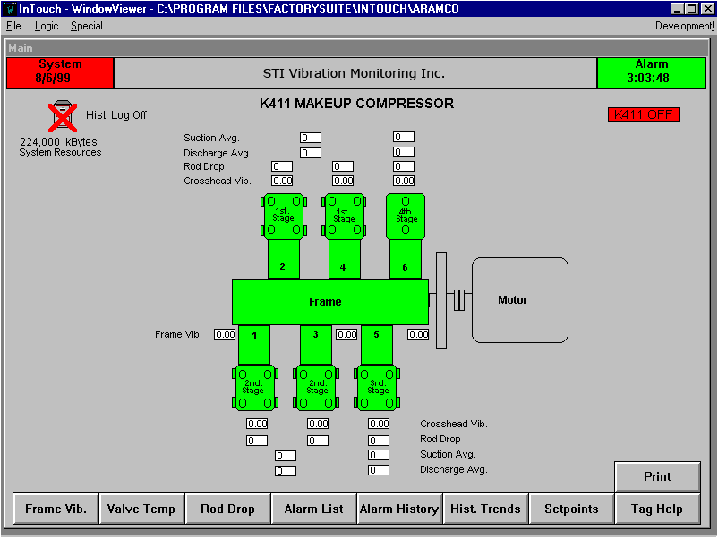
Notes:
This is the main Operator Screen. Valuable measurement parameters such as Global Alarms, Sensor Values are viewed from this display. Hot links are provided to each measurement parameter for trending and alarms.

Slide 20
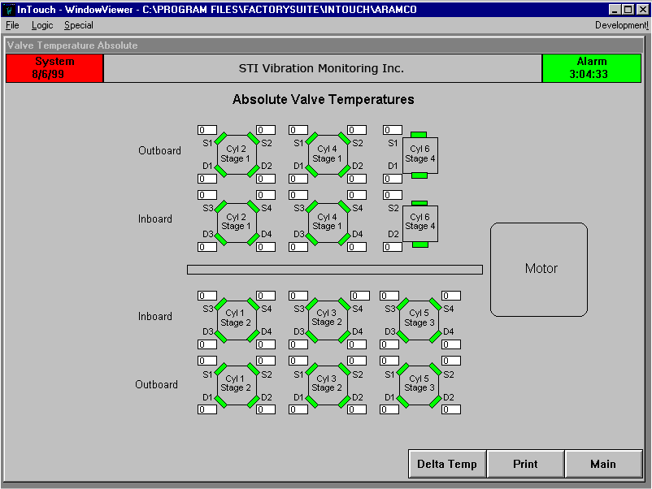
Notes:
Absolute Valve Temperature and Delta Valve temperature may be viewed from these screens.

Slide 21
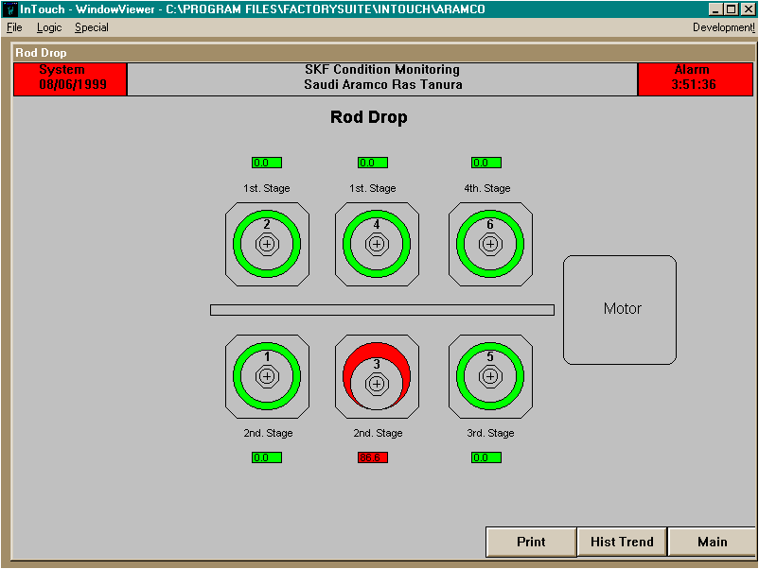
Notes:
Absolute Valve Temperature and Delta Valve temperature may be viewed from these screens.

Slide 22
Notes:
Measured temperature differences of 4 to 20 degrees F can indicate a problem with a valve.

Slide 23
Notes:
As ring wear develops, the piston rod will drop. The operator will see a corresponding color change of yellow for a first level alarm and red for a second level alarm.

Slide 24
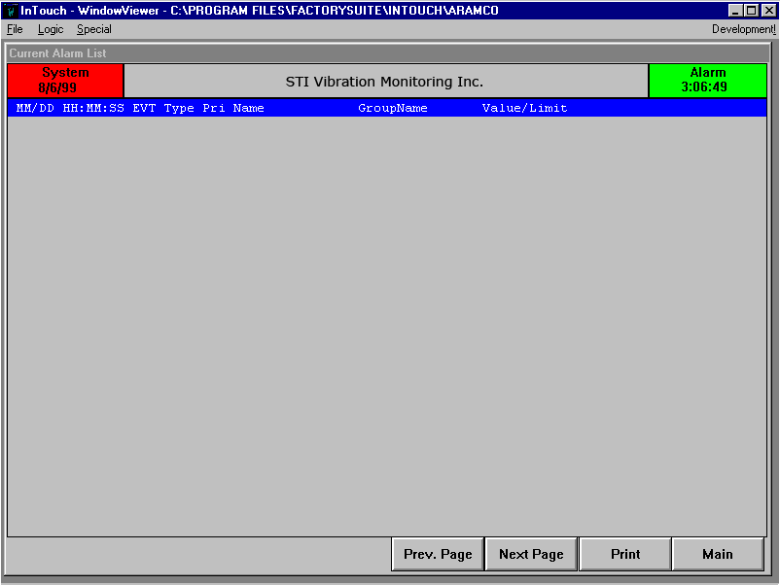
Notes:
Alarm lists are provided in “Current” and “Historical” alarm files.

Slide 26
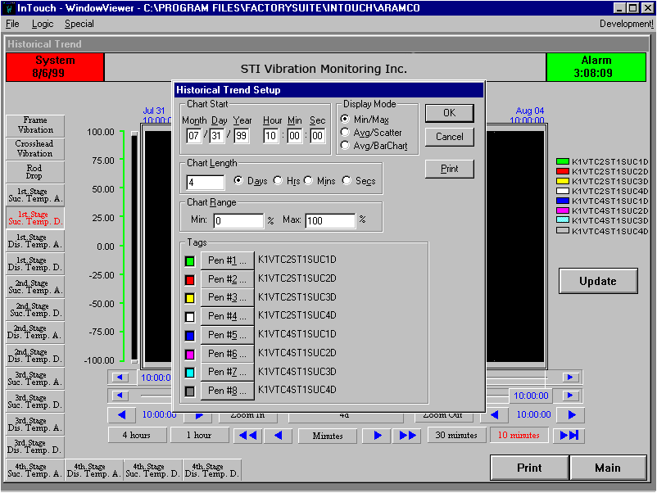
Notes:
Setup for the plots are easily customized for user preference.

Slide 27
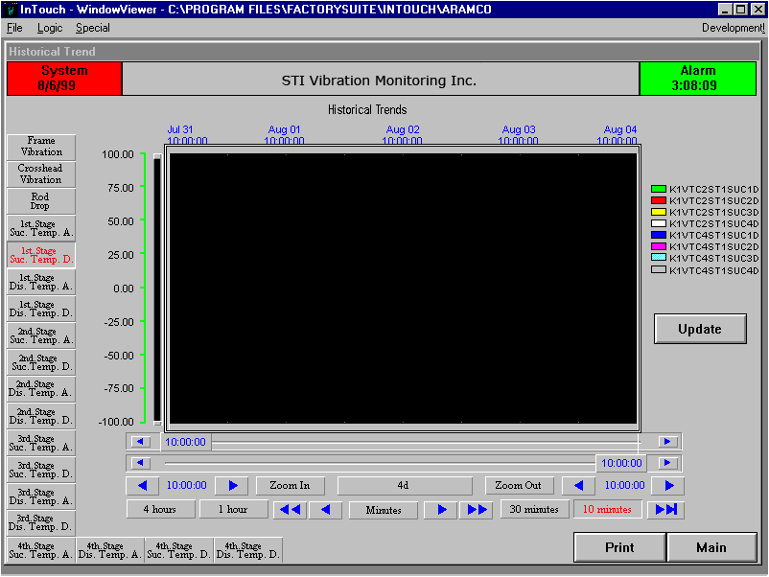
Notes:
Trend plots are available for individual measurement parameters – Here you see a plot for valve temperature.

Slide 28
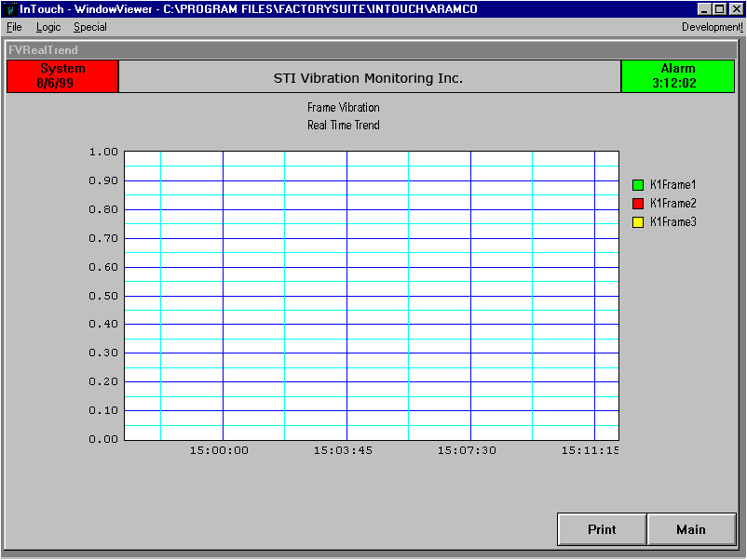

Slide 29
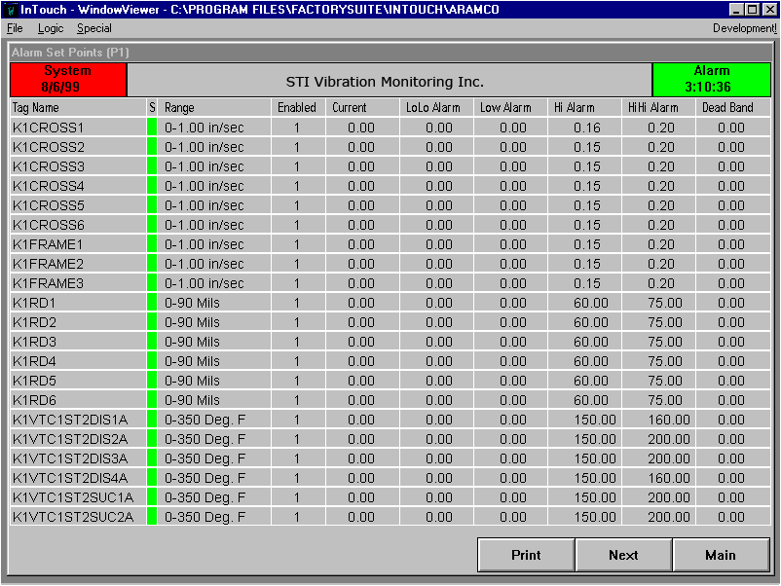
Notes:
Set points for each measurement are password protected and may be changed by the appropriate individual.

Slide 30
Thank You

